Slide 1

LECTURE ONE
INTRODUCTION TO ALGORITHM
Prof. Zhenyu He
Harbin Institute of Technology, Shenzhen

Slide 2

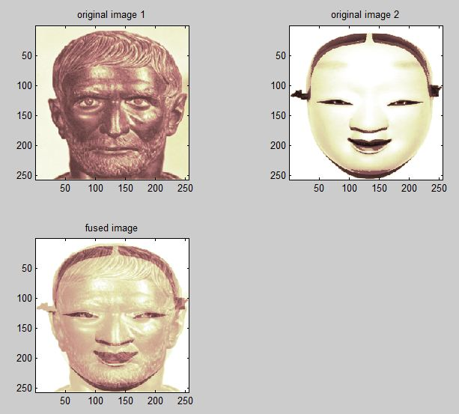
Some examples: fusion

Slide 3
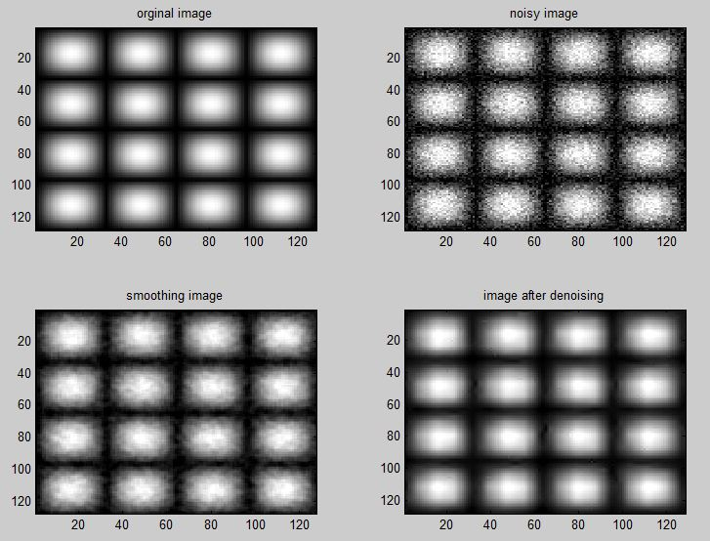
Some examples: denoising

Slide 4
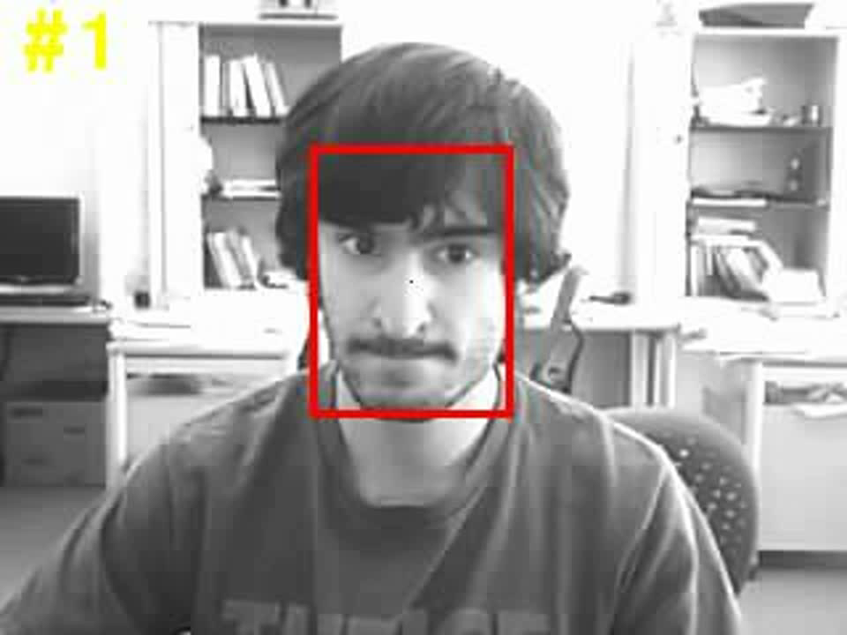
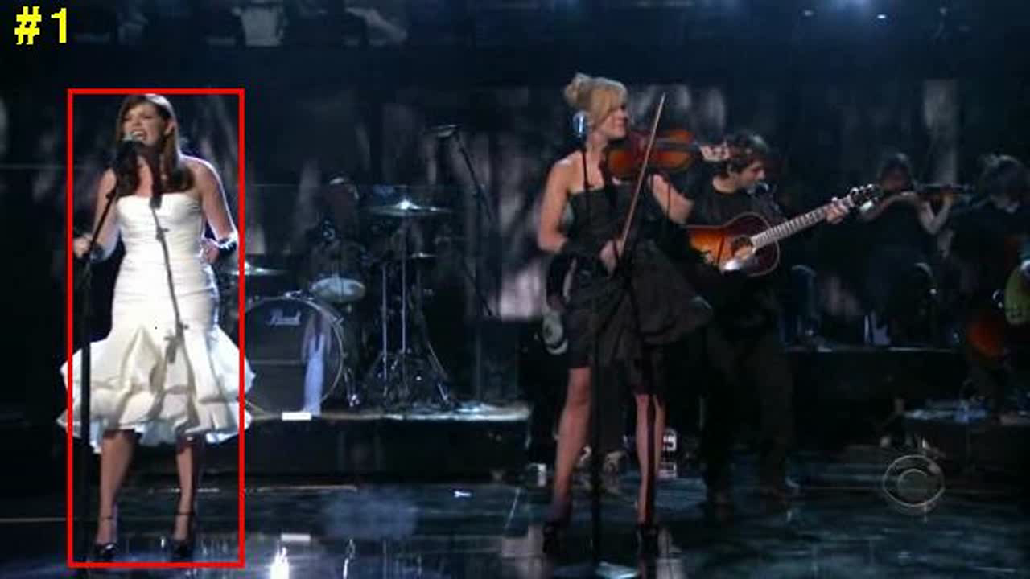
Some examples: object tracking

Slide 5
Algorithms
What?
Why?
How?

Slide 6

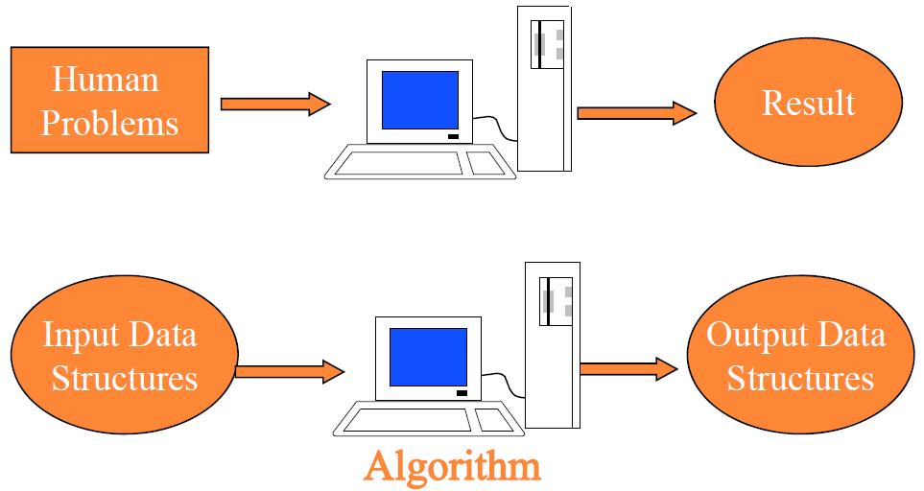
What are algorithms?
An algorithm is a sequence of computational steps that transform the input into the output.

Slide 7
One example: sorting problem
Input: A sequence of n numbers <a₁, a₂,…, a_{n}>
Output: A permutation (recording) sequence <a’₁, a’₂,…, a’_{n}> of the input sequence such that
a’₁≤ a’₂ ≤… ≤ a’_{n.}

Slide 8
Human Problems
Path searching
Input: a road map on which the distance between each pair of adjacent intersections is marked
Output: the shortest route from one intersection to another
Human genome project
Input: 100,000 genes in human DNA.
Output: sequences of 3 billion chemical base pairs.
Internet information management

Slide 9
Why?-The Reasons to Study Algorithm
Become the skilled programmer from the novice.
Cookbook
Master the skills to analysis and design algorithms with high efficiency for new problems

Slide 10
Efficiency
Input: -1, 1, -1, 1, ..., (-1)^{n}
Output: the sum of this sequences.
What do you think of this question?
Algorithm 1
sum = 0;
for (i=1; i<=n; i++)
{
sum = sum+(-1)^n;
}
Execute n+1 times.
Algorithm 2
if(n%2==0)
sum=0;
else
sum=-1;
Execute 1 time

Slide 11
Efficiency
Baseline to evaluate the algorithm
Inserting sort
Merge sort
Cost time : C₁n²
Cost time : C₂nlgn
C₁<C₂
C₁n² < = > C₂nlgn ?

Slide 12
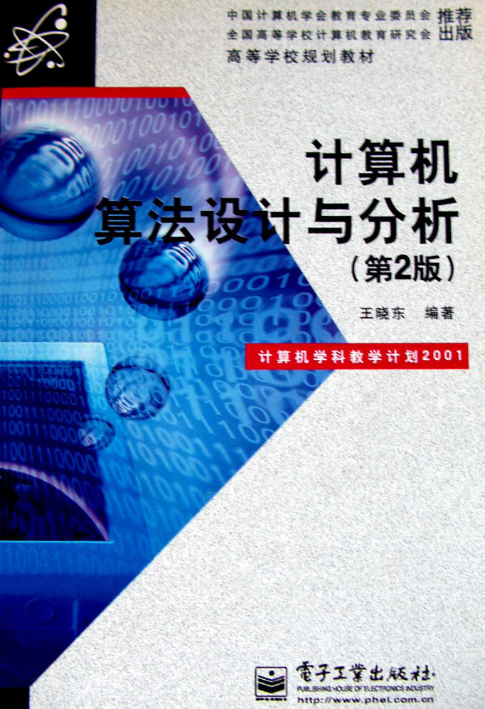
References
计算机算法设计与分析(第2版) 王晓东编著

Slide 13
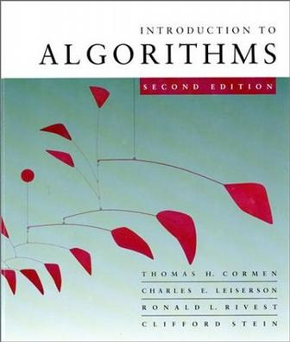
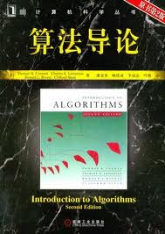
The Trivial
Text book:
Introduction to Algorithm (Second Edition)
Thomas H.Cormen, Charles E.Leiserson, Ronald L.Rivest, Clifford Stein

Slide 14
Prerequisites
Knowledge of Data Structure
A programming Language: C, Java, …, etc.

Slide 15
Schedule
Introduction to Algorithm
Recurrences and Divide-and-Conquer
Quicksort & Sorting in Linear Time
Elementary Data Structures & Hash Function
Binary Search Tree & Red Black Tree & B-Tree
Augmenting Data Structure (Interval Tree)
Dynamic Programming
Greedy Algorithm
Linear Programming
…

Slide 16
Grading
Class participation 5%
Project & Homework 35%
Exam 60%

